Slide 1




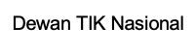
Materi Diskusi No.051/WANTIKNAS/MAT-03/NOV/2023
DIGITAL AND GREEN TECHNOLOGY FOR PLANET
Dr.-Ing Ilham Akbar Habibie, MBA.
Head Of Research And Technology Agency, Chamber Of Commerce,
Executive Chairman, National ICT Council (WANTIKNAS)
Presented on :
COMNETS Workshop Bali 2023
8 -10 November 2023
Bali

Slide 2




ORGANIZATIONAL STRUCTURE
Chamber of Commerce Management
CHAIRMAN
ARSJAD RASJID
Chairman Kadin Indonesia
DEPUTY CHIEF GENERAL COORDINATOR
Deputy General 1, Organizational, Legal and Communication Sectors
Deputy General 2, Economic Sector
Deputy General 3, Maritime, Investment and Foreign Affairs
Deputy General 4, Human Quality Improvement, Research and Technology and Innovation
Head Of Research And Technology Agency
ILHAM HABIBIE
Based on Law Number 1 of 1987, it is established that the Chamber of Commerce and Industry (Kadin) of Indonesia is the forum for all Indonesian entrepreneurs in the state business sector, cooperative enterprises, and private businesses. Accordingly, Kadin Indonesia serves as a forum and vehicle for nurturing, communication, information, representation, consultation, facilitation, and advocacy for Indonesian entrepreneurs.

Slide 3
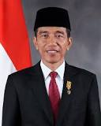
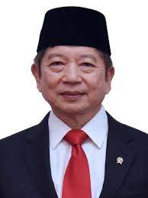
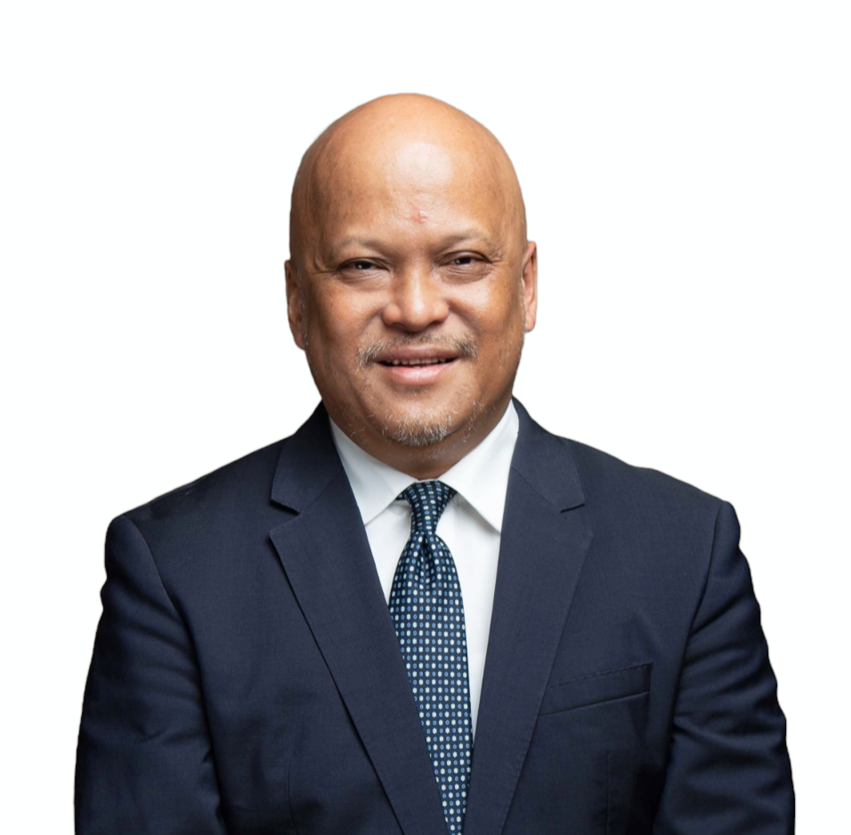
PRESIDENTIAL DECREE NO.1/2014
Structure
Tasks
Steering Committee
Formulate the general policy and strategic direction of national development, through the development of information and communication technology, which includes infrastructure, applications, and content;
Conduct assessment, evaluation, and input in determining the steps to resolve the existing strategic issues for the development of information and communication technology;
Conduct National coordination with Central/ Local Government, State-owned Entreprise/ Regional-owned Enterprises, Businesses, Professional Agencies, and general public in the development of information and communication technology as well as empowering society; and
Provide approvement on the implementation on inter-ministerial information and communication technology development programmes to ensure the effectiveness and efficiency
Chairman
Chief Executive
Executive Team
Multistakeholders
Academicians
Business
Government
Community, Expert, Practitioners
National Development Planning Ministerial Decree No.86/2021
Digital Transformation Development
Chairman

Slide 4

Golden Indonesia 2045 Vision
"Sovereign, Advanced and Sustainable Maritime State"
The Archipelagic State of Nusantara is an island nation that possesses political resilience, economic strength, national security, and a maritime culture/civilization that serves as a pivotal axis in the world's maritime domain
Sovereignty encompasses resilience, unity, self-reliance, security, and fortitude.
Sustainability encompasses enduring and balanced integration of economic, social, and environmental development.
Progress encompasses empowerment, modernity, resilience, innovation, and fairness.
Sumber : https:// https://setkab.go.id/en/president-jokowi-calls-for-grand-strategy-for-indonesias-2045-vision/

Slide 5
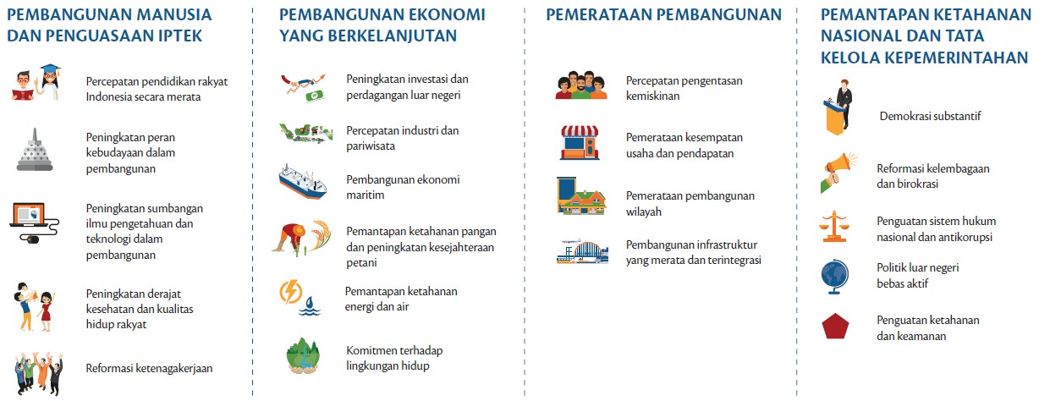
VISION OF INDONESIA 2045
In realizing this dream, Indonesia's Vision 2045 was formulated, which has 4 (four) development pillars, namely:
HUMAN DEVELOPMENT AND SCIENCE AND TECHNOLOGY MASTERY
SUSTAINABLE ECONOMIC DEVELOPMENT
STRENGTHENING NATIONAL RESILIENCE AND GOVERNANCE
EQUITABLE DEVELOPMENT
Accelerate the education of the Indonesian people equally
Increased foreign investment and trade
Accelerating poverty alleviation
Substantive democracy
Increased role of culture in development
Acceleration of industry and tourism
Equitable distribution of business opportunities and income
Institutional and bureaucratic reform
Maritime economic development
Equitable regional development
Strengthening the national legal system and anti-corruption measures
Increased contribution of science and technology in development
Strengthening food security and improving farmers' welfare
Equitable and integrated infrastructure development
Free and active foreign policy
Improved health status and quality of life of the people
Energy and water security strengthening
Strengthening resilience and security
Commitment to the environment
Labor reform
Source : Bappenas “Indonesia 2045:Berdaulat, Maju, Adil, dan Makmur” (2019)
Notes:
Di bhs inggris

Slide 6


IMPORTANCE OF DIGITAL TRANSFORMATION
Enhanced Efficiency and Productivity
Data-Driven Decision Making
Innovation and Agility
Talent Attraction and Retention
TECHNOLOGY
Source: https://economictimes.indiatimes.com/jobs/c-suite/why-digital-transformation-is-critical-for-businesses-to-stay-competitive-in-the-2023-landscape/articleshow/100594911.cms?from=mdr
Notes:
1. Enhanced Efficiency and Productivity: Digital transformation automates repetitive tasks, streamlines processes, and optimizes workflows. By leveraging technology, organizations can improve efficiency and productivity, allowing employees to focus on higher-value tasks and strategic initiatives.
2. Data-Driven Decision Making: Digital transformation allows companies to collect, analyze, and interpret vast amounts of data. Data-driven insights empower organizations to make informed decisions, identify trends, and predict future market dynamics, enhancing their competitive edge.
3. Agility and Adaptability: With rapidly changing market conditions, businesses must be agile and adaptable. Embracing digital technologies enables organizations to respond quickly to market shifts, customer demands, and industry disruptions. Being agile innovative is more important then ever
4. Talent Attraction and Retention: Embracing digital transformation showcases a company's commitment to innovation and modernization, making it more appealing to potential employees. It also fosters an engaging work environment, improving employee retention rates.

Slide 7





DIGITAL TRANSFORMATION IN OTHER COUNTRIES
In developing our strategy, we looked at several countries that are leading the Digital Transformation.
National institutions that drive digital transformation in developed countries...
..... distils the key success factors that catalysed their achievements
Singapore (#1 in DAI)
CFE & FEC
Ensure that supervisory direction is centralised with strong political support
1
South Korea (#4 in DAI)
PCIFR
Prioritising sectors with high potential and high impact
2
Germany (#6 in DAI)
Digital
>
Gathering input from practitioners in priority sectors
3
United Kingdom (#23 in DAI)
Digital economy Council
The government must (digitally) accelerate like the private sector
4
Australia (#33 in DAI)
Australian Digital Economy Council
Build and strengthen enablers along with quick wins
5
Sources : 1. World Bank Adoption Index (Digital Adoption Index (DAI)) as of 2016: 2. Council on the Future Economy (CFE); 3. Future Economy Council (FEC); 4. Presidential Committee on the Fourth Industrial Revolution (PCFIR); Source : Expert interview, BCG analysis,

Slide 8
CURRENT CONDITION
Indonesia’s digital index pulse checks
DigitaI Index | Year | Rank
Global Innovation Index¹ | 2023 | 61/132
UN e-Government Index² | 2022 | 77/193
IMD World Digital Competitivenes Index³ | 2023 | 34/63
Networked Readiness Index⁴ | 2022 | 59/131
Sumber : 1. https://www.wipo.int/edocs/pubdocs/en/wipo_pub_gii_2021/id.pdf, 2. https://publicadministration.un.org/egovkb/en-us/Data/Country-Information/id/78-Indonesia,3. https://dataindonesia.id/digital/detail/daya-saing-digital-indonesia-peringkat-ketiga-terbawah-di-asia 4. https://networkreadinessindex.org/wp-content/uploads/reports/countries/indonesia.pdf

Slide 9

ROLE OF DIGITAL TECHNOLOGIES
Enabler of sustainable practices
Data collection and analysis
Automation and efficiency
Communication and collaboration
Source : Accenture - Digital Technology for a Sustainable Future, bing AI

Slide 10
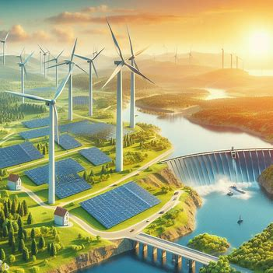
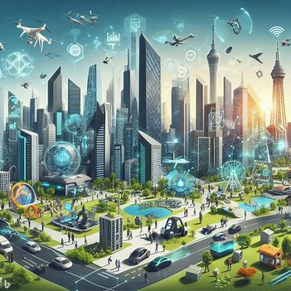

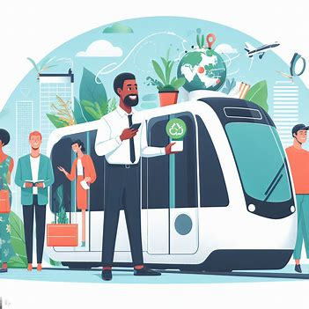

DIGITAL SOLUTIONS FOR SUSTAINABILITY
Renewable energy integration
Smart cities and IoT
Sustainable agriculture
Circular economy practices
Eco-friendly transportation
Source : UN Sustainable Development Goals - Goal 7 and Goal 11

Slide 11






BENEFIT OF DIGITAL AND GREEN TECHNOLOGY
Reduces greenhouse gas emissions
Improves air and water quality
Conserves natural resources
Creates jobs
Protects biodiversity
Boosts economic growth
Source: United Nations Environment Programme: https://www.investopedia.com/terms/g/green_tech.asp, World Economic Forum: https://www.ey.com/en_us/workforce/the-future-of-work-is-green, McKinsey & Company: https://www.canr.msu.edu/news/the_evolution_of_the_new_economy
Notes:
Environmental benefits:
Reduced greenhouse gas emissions: Digital and green technology can help to reduce greenhouse gas emissions by enabling the use of renewable energy sources, improving energy efficiency, and reducing waste. For example, solar panels and wind turbines can generate clean electricity, while energy-efficient appliances and buildings can help to reduce energy consumption.
Reduced pollution: Digital and green technology can also help to reduce pollution of the air, water, and land. For example, electric vehicles produce zero emissions, while smart irrigation systems can help to reduce water usage and pollution from agricultural runoff.
Conservation of resources: Digital and green technology can help to conserve natural resources such as water, minerals, and fossil fuels. For example, desalination plants can produce fresh water from seawater, while recycling and reuse programs can help to reduce the need for new raw materials.
Societal benefits:
Improved public health: Digital and green technology can help to improve public health by reducing air pollution, providing access to clean water and sanitation, and improving healthcare delivery. For example, air quality sensors can help to monitor and reduce air pollution, while telemedicine programs can provide access to healthcare services to people in remote areas.
Increased access to education and employment: Digital technology can help to increase access to education and employment opportunities for people around the world. For example, online learning platforms can provide access to high-quality education to people who live in remote areas or cannot afford traditional tuition fees.
Improved quality of life: Digital and green technology can also help to improve the quality of life for people around the world. For example, smart city technologies can help to improve traffic flow, reduce crime rates, and make cities more livable.
Economic benefits:
Job creation: The digital and green economy is growing rapidly and creating new jobs in a variety of sectors, including renewable energy, energy efficiency, and waste management.
Increased productivity: Digital technology can help to increase productivity and efficiency in businesses and organizations of all sizes. For example, cloud computing can help businesses to reduce IT costs and scale their operations more easily.
New market opportunities: Digital and green technology are creating new market opportunities for businesses and entrepreneurs. For example, the growing demand for electric vehicles is creating new opportunities for businesses that develop and manufacture these vehicles.

Slide 12






ADOPTION OF DIGITAL AND GREEN TECHNOLOGY
Providing financial incentives
Educating and training the public
Investing in research and development
Creating a supportive regulatory environment
Making digital and green technologies more accessible and affordable
Source: OECD, "How to accelerate green technology diffusion?" (2023), https://www.oecd.org/naec/new-economic-policymaking/Kerstin_H%C3%B6tte.pdf
Notes:
Investing in research and development. Governments and businesses need to invest in research and development to create new digital and green technologies, and to improve the performance and affordability of existing technologies.
Providing financial incentives. Governments can provide financial incentives, such as tax breaks or subsidies, to encourage businesses and individuals to adopt digital and green technologies.
Creating a supportive regulatory environment. Governments can create a supportive regulatory environment for digital and green technology, by removing barriers to adoption and creating incentives for innovation.
Educating and training the public. It is important to educate and train the public on how to use digital and green technologies. This can be done through school programs, public awareness campaigns, and government-funded training programs.
Making digital and green technologies more accessible and affordable. Digital and green technologies should be made more accessible and affordable for everyone, regardless of income or location. This can be done by expanding access to broadband internet, providing discounts on digital devices, and offering financial assistance for energy efficiency improvements.

Slide 13



THE NEED FOR GREEN TECHNOLOGY
Environmental challenges (climate change, pollution, resource depletion)
The urgency of sustainable solutions
Transitioning from traditional technology to green technology
Source : World Economic Forum - The Global Risks Report 2021

Slide 14
GREEN TECHNOLOGY INITIATIVES
Sustainable design and manufacturing
Energy-efficient solutions
Carbon footprint reduction
Eco-certifications
E-waste reduction
2.
Economic
uncertainty
Source : Green Technology Initiatives: An Overview

Slide 15
OPPORTUNITIES AND CHALLENGES
S
W
STRENGTHS
WEAKNESSES
Demographics: 65% digital native
Special state budget allocation for ICT
Policies that focus on science and technology development (RPJMN, Indonesia's vision 2045, Stranas KA)
ICT infrastructure will help ICT implementation (e.g. Palapa Ring)
Lack of digital literacy
Low cyber-attack awareness
Digital Leadership needs to be improved
Digital infrastructure is vulnerable to cyber attacks
Existing programmes related to digital transformation have not been collaborated optimally
O
T
OPPORTUNITIES
THREATS
Technology innovation drives security development
Programmes for digital upskilling will help with general technology understanding
Increasing digital talent in MSMEs increases GDP and reduces economic disparities
ICT infrastructure development included in the RPJMN 2020-2024 Strategic Programmes
Large number of internet users
Digital Divide can widen gaps in education, health and economy
Increased hate speech on social media that encourages division
Lack of digital human resources and domestic science and technology innovation resulting in high recruitment of foreign labour and use of foreign products
The development of extremist groups on social media

Slide 16
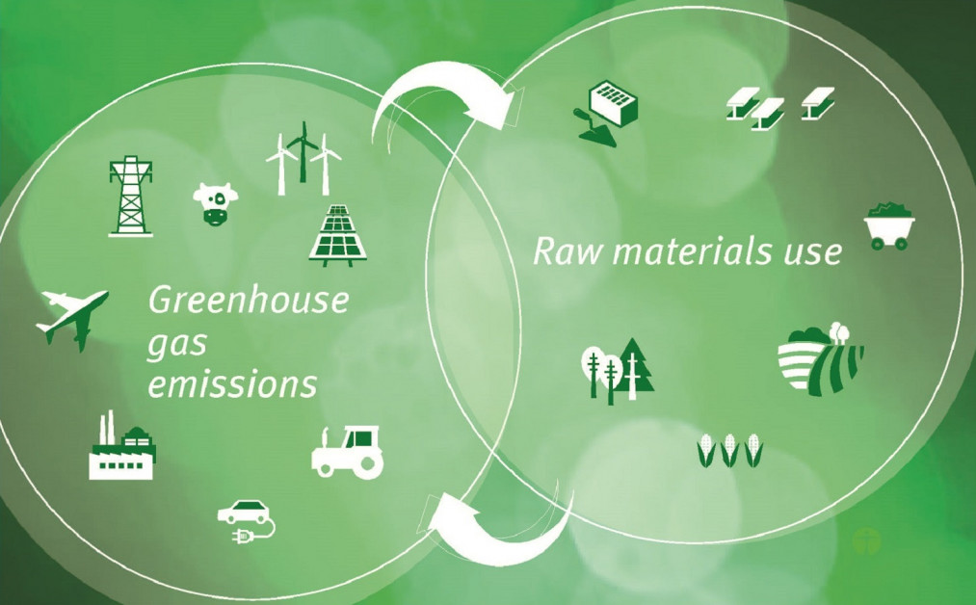
DECARBONIZATION AS A MEGATREND
Sumber : https://www.alfinas.com/post/decarbonization-as-a-megatrend-what-it-means-for-investors

Slide 17

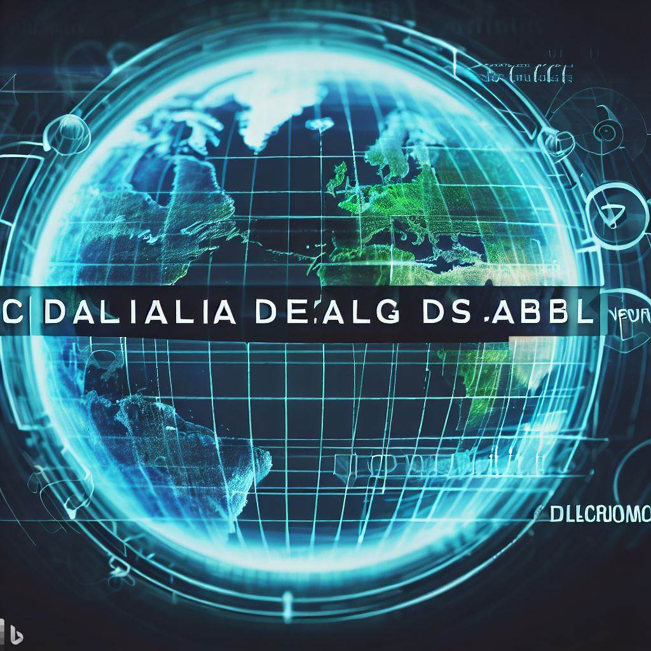
3D CHALLENGE
DEGLOBALISASI
DECARBONISASI
DIGITALISASI
DEGLOBALISASI - DECARBONISASI - DIGITALISASI
17

Slide 18






6 STRATEGIES FOR BALI'S ECONOMIC TRANSFORMATION
Smart and Healthy Bali
Bali Green
Productive Bali
Bali Smart Island
Bali Integrated
Bali Conducive
Source: Peta Jalan Ekonomi Kerthi Bali
Notes:
1. Smart and Healthy Bali
Transformasi pembangunan kesehatan dan pendidikan yang bertujuan untuk meningkatkan produktivitas Sumber Daya Manusia (SDM) Bali. Peningkatan kualitas SDM melalui strategi mewujudkan SDM sehat bergizi, SDM cerdas berkarakter kuat dan SDM yang kreatif dan inovatif.
2. Bali Hijau
skenario penerapan kebijakan mitigasi dan adaptasi perubahan iklim yang ambisius, sehingga tercapai penurunan Green House Gases (GHG) di level Net Zero Emission pada tahun 2060 atau lebih cepat, dan pertumbuhan penyerapan tenaga kerja di sektor ekonomi hijau antara 50.000 sampai 100.000 lapangan pekerjaan baru
3. Bali Smart Island
penguatan infrastruktur digital (100% coverage dan berkualitas), peningkatan SDM trampil digital, pengembangan berbagai pelayanan publik dan swasta secara digital serta digitalisasi perekonomian Bali antara lain digitalisasi start up UMKM dan ekonomi kreatif, dan pengembangan layanan wisata digital.
4. Bali Produktif
strategi peningkatan produktivitas tenaga kerja menuju pekerja kelas menengah, modernisasi pertanian, modernisasi kelautan dan perikanan, peningkatan 16 industrialisasi, penguatan sektor pariwisata, pengembangan ekonomi kreatif dan penguatan UMKM dan penguatan sektor pariwisata, produktivitas tenaga kerja Bali akan mengalami peningkatan sebesar tiga kali lipat dibandingkan rata-rata produktivitas tahun 2015-2019
5. Bali Terintegrasi
peningkatan sarana dan prasarana konektivitas, pengembangan Bali sebagai hub logistik udara, penguatan kerja sama Bali-Nusra, serta pengembangan skema inovatif pembiayaan infrastruktur
6. Bali Kondusif
penguatan enabler atau faktor pengungkit pertumbuhan ekonomi jangka panjang, yaitu: aspek keuangan daerah, aspek pembiayaan usaha, dari aspek kemudahan berusaha, dan aspek reformasi birokrasi, serta perbaikan tata kelola dan kelembagaan.

Slide 19






BALI DIGITAL TRANSFORMATION
Digital Transformation of Kerthi Bali Economy
Digital Transformation of Villages and Customary Villages
Agriculture Digitalization
Digitalization of Marine and Fisheries
Digitalization of Industry
Digitalization of SMEs, MSMEs, and Cooperatives
Digitalization of Creative and Digital Economy
Digital Tourism
Digital Village
Digital Indigenous Village
Smart LPD
Integrated Bumdes and Bupda
Sad Kerthi Semesta Bali Data Collection
Krama Bali Welfare and Happiness Index
Digital Fab Lab
Integrated Bali Digital Transformation
SPBE
Superior Balinese Human Digital Transformation
Intelligent Transport System
Financial Technology
Bali Digital Market
Krama Bali Online Transport
Bali Media Centre
Strengthening the Quality of Digital Infrastructure
Digitalization of the Education Sector
Certified Krama Bali Online Training
Digital Fab Lab
Digital Area Development
Strengthening and Accelerating Digital Literacy
Digital Community and Start-Up Strengthening
Bali's Digital Transformation as a Centre of World Civilisation
Bali Kerta Digital Transformation
Bali Digital Museum of Culture
Bali Culture Metaverse
Bali Culture Live Event
Big Data Ceraken Bali Culture
Digitalization of Subak Area
New Era Integrated Bali Website
Krama Bali Sehat Digital Service
Safe Bali Digital Service
Environment Digital Service
Social Security Digital Service
Labour Digital Service
Democracy and Law Digital Service
Source: Peta Jalan Ekonomi Kerthi Bali

Slide 20
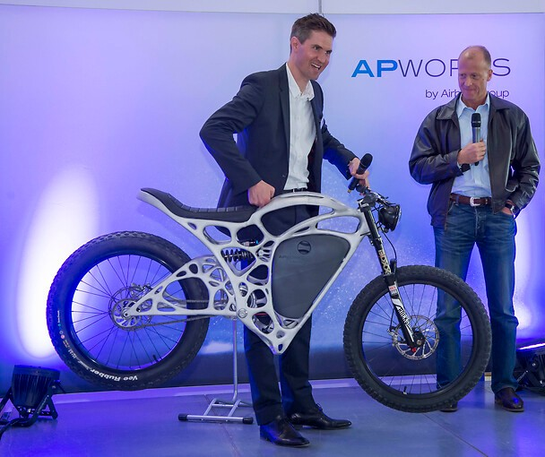

BALI DIGITAL FAB LAB
Declaration on October 12Th, 2022
"With Bali becoming a Fab Island, the tourism sector, which currently dominates Bali's economy, will be developed or empowered with a new type of tourism, namely technology-based tourism.”
I Wayan Koster – Governor of Bali Province
Bali as Bali Fab Island will be able to design and produce for example electric motorbikes using industry 4.0/mini factory principles
20

Slide 21





CONCLUSION
Importance of Digital Transformation
Digital Solutions for Sustainability
Golden Indonesia 2045 Vision
Digital solutions for sustainability encompass renewable energy, smart cities, sustainable agriculture, circular economy practices, and eco-friendly transportation
Indonesia envisions becoming a sovereign, advanced, and sustainable maritime state
Digital transformation is a crucial concept in modernizing various aspects of society.
Benefit of Digital and Green Technology
Decarbonization as a Megatrend
Digital and green technology offers environmental benefits, reducing emissions, pollution, and conserving resources
Decarbonization is a significant global trend that focuses on reducing carbon emissions
Notes:
Di bhs inggris

Slide 22
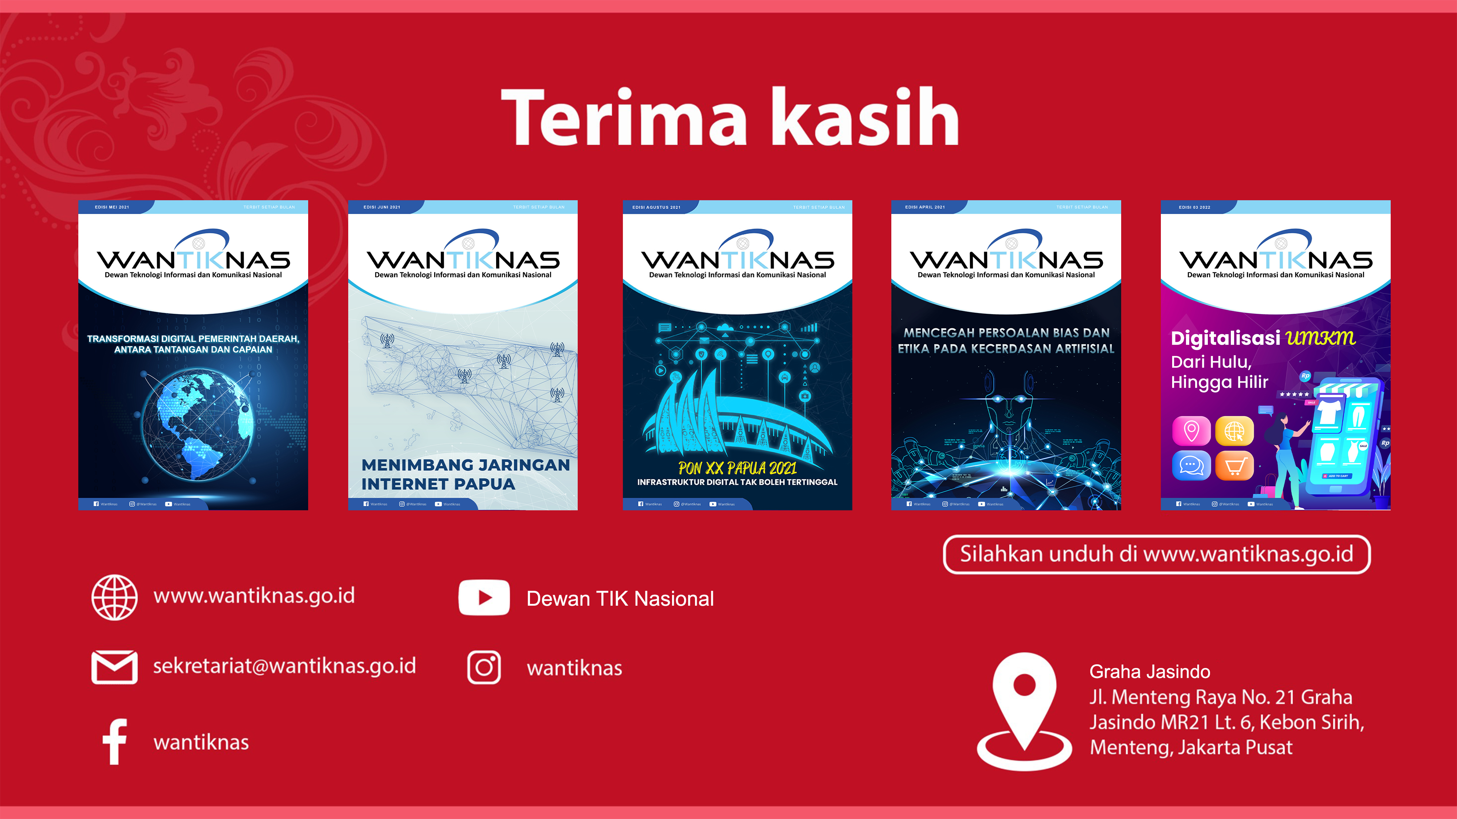
Terimakasih
THANK YOU

